Slide 1

Principal Components Analysis (PCA)
Debajyoti Biswas

Slide 2
Curse of Dimensionality
The curse of dimensionality refers to various phenomena that arise when analyzing and organizing data in high-dimensional spaces that do not occur in low-dimensional settings such as the three-dimensional physical space of everyday experience.
The curse generally refers to issues that arise when the number of datapoints is small (in a suitably defined sense) relative to the intrinsic dimension of the data.
When the dimensionality increases, the volume of the space increases so fast that the available data become sparse. In order to obtain a reliable result, the amount of data needed often grows exponentially with the dimensionality. As the number of features or dimensions grows, the amount of data we need to generalize accurately grows exponentially.

Slide 3
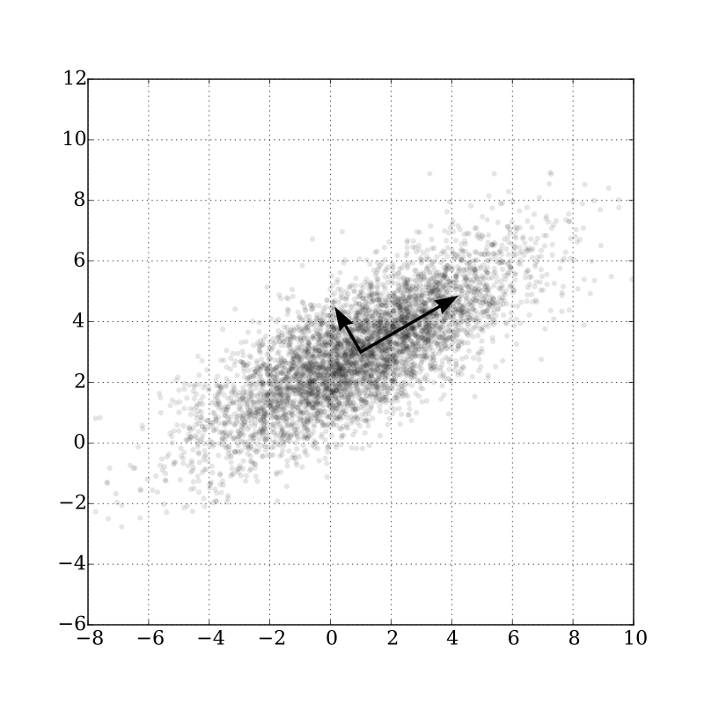
PCA
A dimensionality reduction technique with applications in exploratory data analysis, visualization and data preprocessing.
Dimensionality reduction, or dimension reduction, is the transformation of data from a high-dimensional space into a low-dimensional space so that the low-dimensional representation retains some meaningful properties of the original data, ideally close to its intrinsic dimension.
Principal Component Analysis (PCA) is a technique for dimensionality reduction that identifies a set of orthogonal axes, called principal components, that capture the maximum variance in the data.

Slide 4
PCA
The principal components are linear combinations of the original variables in the dataset and are ordered in decreasing order of importance. The total variance captured by all the principal components is equal to the total variance in the original dataset.
The first principal component captures the most variation in the data, but the second principal component captures the maximum variance that is orthogonal to the first principal component, and so on.
PCA employs a linear transformation that is based on preserving the most variance in the data using the least number of dimensions.

Slide 5
PCA
The principal components of a collection of points in a real coordinate space are a sequence of p unit vectors, where the i-th vector is the direction of a line that best fits the data while being orthogonal to the first i−1 vectors.
Here, a best-fitting line is defined as one that minimizes the average squared perpendicular distance from the points to the line.
Many studies use the first two principal components in order to plot the data in two dimensions and to visually identify clusters of closely related data points.

Slide 6
Recursive Feature Elimination (RFE)
Given an external estimator that assigns weights to features (e.g., the coefficients of a linear model), the goal of recursive feature elimination (RFE) is to select features by recursively considering smaller and smaller sets of features
First, the estimator is trained on the initial set of features and the importance of each feature is obtained either through any specific attribute (such as coef_, feature_importances_)
Then, the least important features are pruned from current set of features.
That procedure is recursively repeated on the pruned set until the desired number of features to select is eventually reached.

Slide 7
Recursive Feature Elimination Cross Validation (RFE-CV)
RFECV performs RFE in a cross-validation loop to find the optimal number of features.
The number of features selected is tuned automatically by fitting an RFE selector on the different cross-validation splits (provided by the cv parameter).
The performance of the RFE selector are evaluated using scorer for different number of selected features and aggregated together.
Finally, the scores are averaged across folds and the number of features selected is set to the number of features that maximize the cross-validation score.

